Slide 1
Support Vector Machines

Slide 2
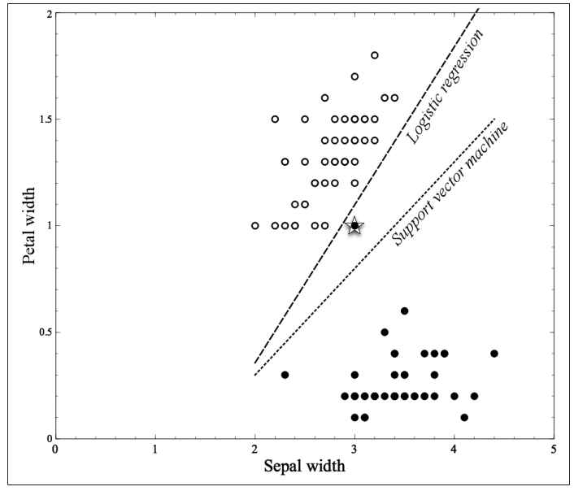
Linear Discriminant
Linear discriminant is a classification solution that discriminates between the classes, and the
function of the decision boundary is a linear combination—a weighted sum—of the
attributes.
In the two dimensions, the linear combination corresponds to a line.
In three dimensions, the decision boundary is a plane, and in higher dimensions it is a hyperplane.

Slide 3
Linear Discriminant
What is Linear Discriminant solution?
The solution is based around some linear combination of attributes.
As in:
1: Logistic Regression
2: Support Vector Machines

Slide 4
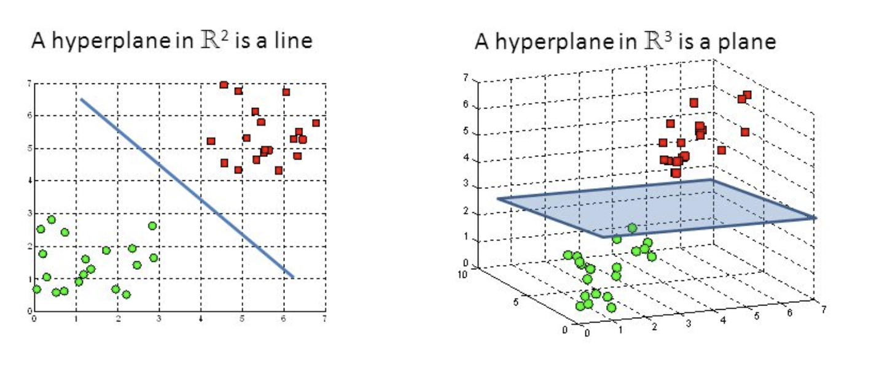
Decision Boundary and Hyperplane

Slide 5
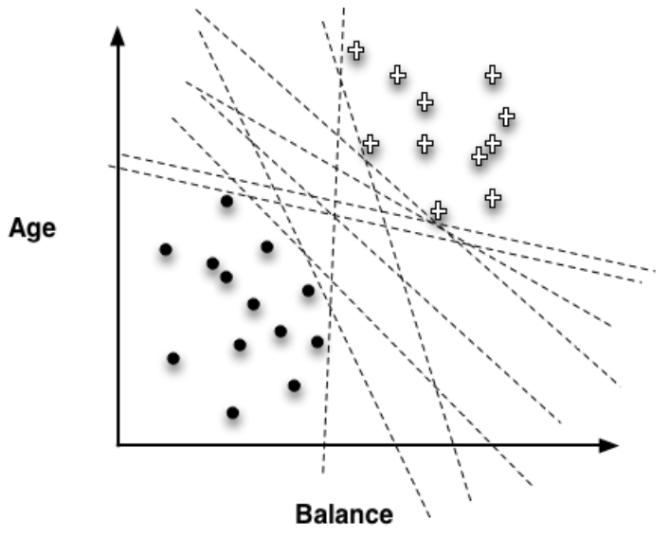
SVM as a Classifier
Many different possible linear boundaries can separate the two groups of points:

Slide 6
SVM as a Classifier
Figure before shows the infinitude of different possible linear discriminants that
would separate the classes, and recall that choosing an objective function for fitting the
data amounts to choosing which of these lines is the best.
SVMs choose based on a simple, elegant idea: instead of thinking about separating with a line, first fit the fattest bar between the classes.
This is shown by the parallel dashed lines in Figure on next slide.
The SVM’s objective function incorporates the idea that a wider bar is better. Then once
the widest bar is found, the linear discriminant will be the center line through the bar
(the solid middle line in Figure shown on next slide).
The distance between the dashed parallel lines is called the margin around the linear discriminant, and thus the objective is to maximize the margin.

Slide 7
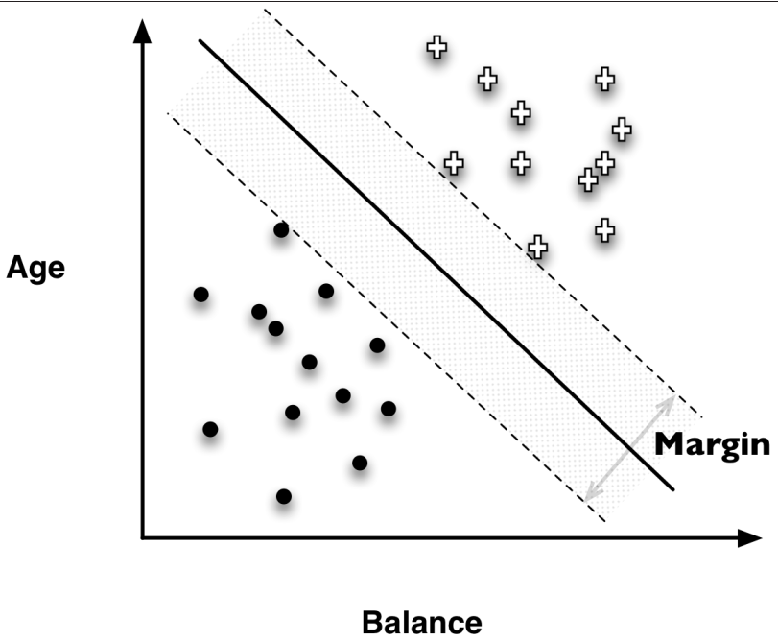
SVM as a Classifier
Instead of fitting a line to separate the two groups of points, what SVM does is it fits a bar like street from between those points.
SVM tries to maximise the width of this bar or street while touching one point from white plus group and while touching one point from black circles group.
These two points which the bar or street touches are called support vectors.

Slide 8
Loss Function in SVM
Is it just the margin that we need to care about?
How about the points that are on the wrong side of the decision boundary?

Slide 9
How SVMs handle points falling on the wrong side of the discrimination boundary
In most data from complex real-world applications—some data points will inevitably be misclassified by the model.
Once again, the support-vector machine’s solution is intuitively satisfying.
The idea is as follows.
In the objective function that measures how well a particular model fits the training points, we will simply penalize a training point for being on the wrong side of the decision boundary.
In the case where the data indeed are linearly separable, we incur no penalty and simply maximize the margin.
If the data are not linearly separable, the best fit is some balance between a fat margin and a low total error penalty.
The penalty for a misclassified point is proportional to the distance from the decision boundary, so if possible the SVM will make only “small” errors. Technically, this error function is known as hinge loss.

Slide 10
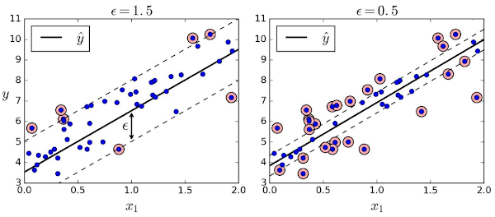
On a side note: SVMs can also be used as Regressor
Instead of trying to fit the largest possible street between two classes while limiting margin violations, SVM Regression tries to fit as many instances as possible on the street while limiting margin violations (i.e., instances off the street).
The width of the street is controlled by a hyperparameter ϵ (in Scikit-Learn).
Figure below shows two linear SVM Regression models trained on some random linear data, one with a large margin (ϵ = 1.5) and the other with a small margin (ϵ = 0.5).

Slide 11
On a side note: SVMs can also be used as Regressor
When your objective is regression instead of classification:
Instead of passing a street from between the points while miximising the street width, you pass a street from over the points while maximing the number of points that line / street / decision boundary touches.

Slide 12
On a side note: Logistic Regression can be generalized for use for more than two classes. Support Vector Machines can be used for non-linear decision boundary.
You may also hear of nonlinear support vector machines.
Oversimplifying slightly, a nonlinear SVM uses different features (that are functions of the original features), so that the linear discriminant with the new features is a nonlinear discriminant with the original features.
For example, if an input sample is two dimensional and of the form [a, b], the degree-2 polynomial features are [1, a, b, a^2, ab, b^2]
If you have features [a, b, c], the default polynomial features (in skLearn the degree is 2) should be [1, a, b, c, a^2, b^2, c^2, ab, bc, ca].
Ref: https://scikit-learn.org/stable/modules/generated/sklearn.preprocessing.PolynomialFeatures.html

Slide 13
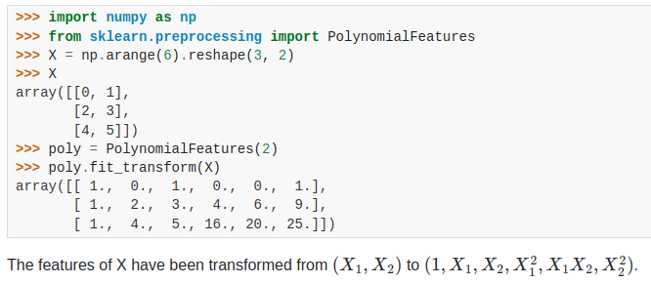
Developing Polynomial Features to Build Non-linear Decision Boundary
Basically what we are doing is increasing the number of features through polynomial transformation:
[a, b] transformed by Degree-2 polynomial would produce: [1, a, b, a^2, ab, b^2]
[a, b, c] transformed by Degree-2 polynomial would produce: [1, a, b, c, a^2, b^2, c^2, ab, bc, ca]
[a, b, c] transformed by Degree-3 polynomial would produce: ['1', 'a', 'b', 'c', 'a^2', 'a b', 'a c', 'b^2', 'b c', 'c^2', 'a^3', 'a^2 b', 'a^2 c', 'a b^2', 'a b c', 'a c^2', 'b^3', 'b^2 c', 'b c^2', 'c^3']

Slide 14
SVM is a supervised learning algorithm
What is supervised learning?
That algorithm needs to see labeled data along with the features to learn the relationship between target and feature.
But with SVM there is a One-Class SVM variant that does unsupervised learning to identify outliers or novelties in the data.

Slide 15
Outlier Detection: Using One-Class SVM
One-Class SVM
SVM or “Support Vector Machine” is a supervised classification model. One-class SVM is its unsupervised sibling for use in Outlier Analysis.
According to skLearn documentation:
The sklearn.svm.OneClassSVM is known to be sensitive to outliers and thus does not perform very well for outlier detection.
This estimator is best suited for novelty detection when the training set is not contaminated by outliers. That said, outlier detection in high-dimension, or without any assumptions on the distribution of the inlying data is very challenging, and a One-class SVM might give useful results in these situations depending on the value of its hyperparameters.

Slide 16
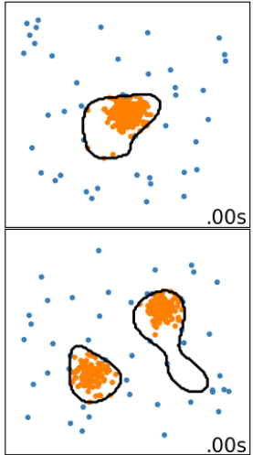
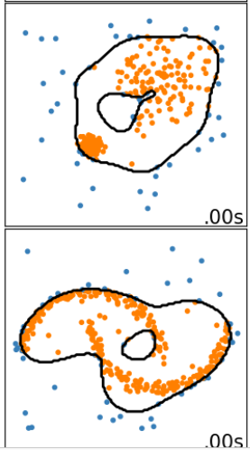
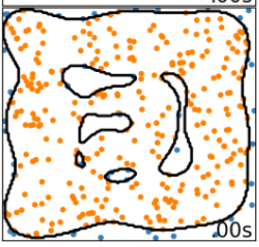
Decision Boundaries With One-Class SVM

Slide 17
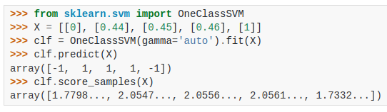
In Code: One-Class SVM
>>> from sklearn.svm import OneClassSVM
>>> X = [[0], [0.44], [0.45], [0.46], [1]]
>>> clf = OneClassSVM(gamma='auto').fit(X)
>>> clf.predict(X)
array([-1, 1, 1, 1, -1])
>>> clf.score_samples(X)
array([1.7798..., 2.0547..., 2.0556..., 2.0561..., 1.7332...])

